Slide 1

Frontend JavaScript
Objects Advanced
www.pragmatic.bg
Lector: Stiliyan Ivanov
Skype: stiliyan.iv.ivanov
E-mail: stiliyan.ivanov [at] pragmatic.bg
Facebook: https://www.facebook.com/stiliyan.iv.ivanov
LinkedIn: https://www.linkedin.com/pub/stiliyan-ivanov/33/2a0/bb5
Copyright © Pragmatic LLC 2013 – 2016

Slide 2

Table of contents
Class declaration
Abstraction
Inheritance
Polymorphism
Encapsulation

Slide 3
Class declaration
Live example

Slide 4
Abstraction
Hiding complexity

Slide 5
Abstraction
One of the four concepts in OOP
Abstraction is to represent essential features of a system without getting involved in the complexity of the entire system
It allows the user to hide non-essential details relevant to user
It allows only to show the essential features of the object to the end user
In other sense we can say it deals with the outside view of an object (interface)

Slide 6
Abstraction example
Every day in our life we use abstraction ignoring the
details which don't concern us
Example:
When using some device for memory storage (flash
memory, hard disk, CD) we don't care how it works
inside. We need to know only how to copy, paste and
delete files on it.

Slide 7
Inheritance
Inherit properties from other classes

Slide 8
Inheritance
Inheritance is one of principles of the OOP
Inheritance is the ability of a class to implicitly gain some(or all) members of another class
Inheritance builds a relationship between classes
The class that gains the functionality is called subclass (child class or derived class). The other class is called base(parent or superclass)
The main purpose of inheritance is reusability of the code

Slide 9
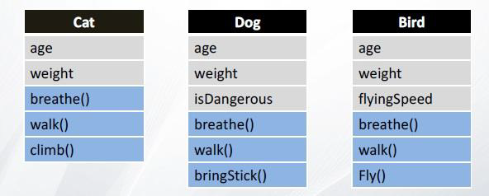
Problem
Cats, dogs and birds have age and weight.
They also can breathe and walk.
Actually, they are animals and every animal has age, weight and can breathe and walk.

Slide 10
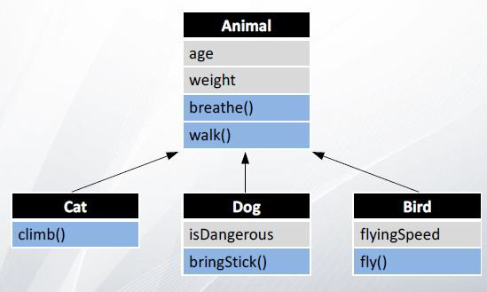
Problem…
Is this the same?
Yes, but the common logic is only in the class Animal

Slide 11
Inheritance in JavaScript
Inheritance in JavaScript is provided through several forms. Prior EcmaScript6 and after that.
Each class can extend only one class

Slide 12
Live Example

Slide 13
‘is a’ and ‘has a’ relationship
Two of the main techniques for code reuse are class inheritance and object composition
'is a' relationship is expressed with inheritance
'has a' relationship is expressed with composition
Example using classes House, Building and Bathroom
Is a: House is a Building
has a: House has a Bathroom

Slide 14
Inheritance vs Composition
Inheritance is uni-directional:
House is a Building. But Building is not a House.
Inheritance uses extends keyword
Composition is used when House has a Bathroom. It is incorrect to say House is a Bathroom
Composition simply means using instance variables that refer to other objects. The class House will have an instance which refers to a Bathroom object

Slide 15
Polymorphism
Having many shapes

Slide 16
Polymorphism
Polymorphism is one of the four concepts in OOP
Polymorphism is the characteristic of being able to assign a different meaning or usage to something in different contexts
In other word, a variable with a given name may be allowed to have different forms and the program can determine which form of the variable to use at the time of execution
In JavaScript polymorphism is achieved by overriding methods in the subclass
Polymorphism is a generic term that means 'many shapes'

Slide 17
Method overriding
A subclass can predefine the methods of its parent
This is called overriding
To override a method:
Use its name as it's in the parent class
Use the same number and order of method arguments
Use the same return type(or subtype of the type returned by the overridden method. This is called a covariant return type)

Slide 18
Method overriding…
Birds can fly. The eagle and the sparrow are birds and can fly. Although the eagle can fly highly and fast.
class Eagle extends Bird {
fly() {
console.log("Flying highly like an eagle");
}
}
class Sparrow extends Bird {
fly() {
console.log("Flying like a sparrow");
}
}

Slide 19
Method overriding…
Overriding is used for Polymorphism
You can invoke the parent method when overriding it - keyword super is used
Try to override method startEngine in class SportCar.
In the body of the method first invoke startEngine of the parent, and then switch on the turbo.

Slide 20
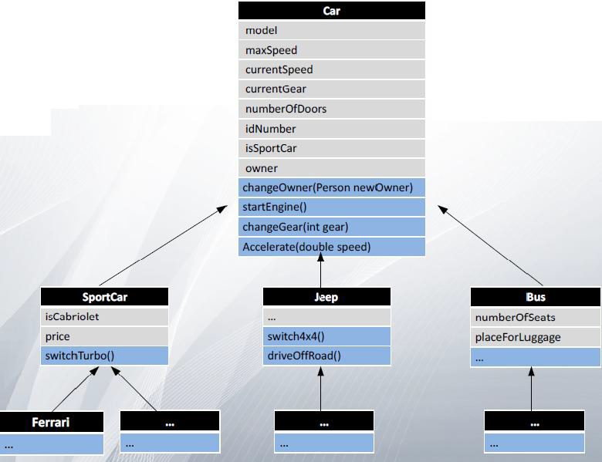
Car example

Slide 21
Subclass constructor EcmaScript6
Invocation of a superclass constructor must be the first line in the subclass constructor
Keyword super is used for this
If a constructor does not explicitly invoke a superclass constructor, JavaScript automatically inserts a call to the default constructor of the superclass.

Slide 22
Super for fields and methods
Subclasses classes can use functionality of the parent class through the keyword super
Super can be used for methods or constructors of the super class
You can declare a field in the subclass with the same name as the one in the superclass (not recommended)
Try setting isSportCar to true in class Car.
What happen if class SportCar declare its own field isSportCar?

Slide 23
Encapsulation
Binding data and methods together

Slide 24
Encapsulation
Encapsulation is an Object Oriented Programming concept that binds together the data and functions that manipulate the data, and that keeps both safe from outside interference and misuse. Data encapsulation led to the important OOP concept of data hiding.
Data encapsulation is a mechanism of bundling the data, and the functions that use them and data abstraction is a mechanism of exposing only the interfaces and hiding the implementation details from the user.
http://www.tutorialspoint.com/cplusplus/cpp_data_encapsulation.htm

Slide 25
Encapsulation…
In programming languages, encapsulation is used to refer to one of two related but distinct notions, and sometimes to the combinationthereof:
A language mechanism for restricting direct access to some of the object's components.
A language construct that facilitates the bundling of data with the methods (or other functions) operating on that data.
Some programming language researchers and academics use the first meaning alone or in combination with the second as a distinguishing feature of object-oriented programming, while other programming languages which provide lexical closures view encapsulation as a feature of the language orthogonal to object orientation.
The second definition is motivated by the fact that in many OOP languages hiding of components is not automatic or can be overridden; thus, information hiding is defined as a separate notion by those who prefer the second definition.
The features of encapsulation are supported using classes in most object-oriented programming languages, although other alternatives also exist.

Slide 26
Getters and Setters
Getters are used for getting the value of private field outside the class.
It should be implemented only if is necessary
Setters are void methods and are used for setting the value of private field outside the class
Validation can be implemented as part of the setter's body

Slide 27
Access modifiers
JavaScript has not access modifiers
Emulated with closures

Slide 28
Difference from other languages
JavaScript has no:
Access modifiers – public, private, protected
Abstract classes, abstract functions
Interfaces, Traits
Destructors
Final keyword

Slide 29
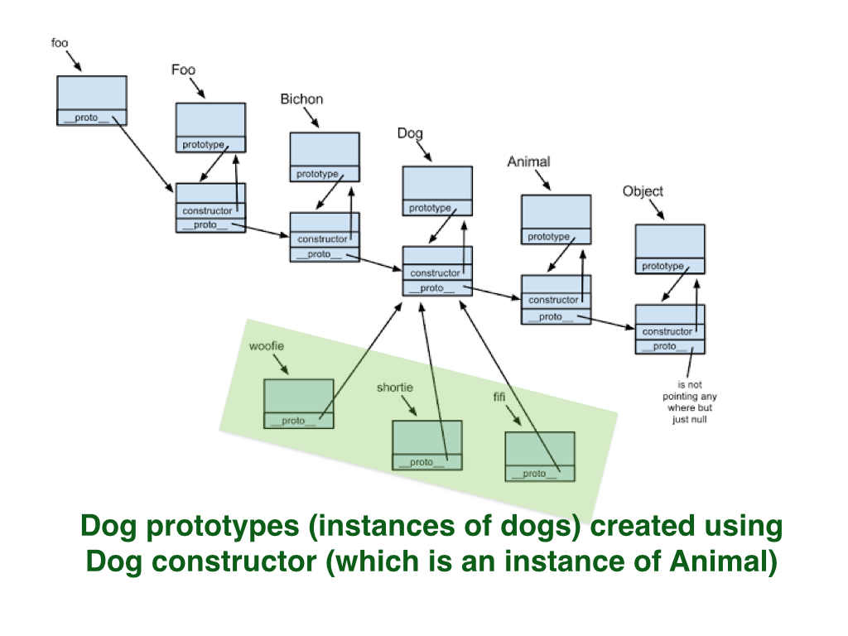
Prototype chain

Slide 30

Questions?

Slide 31
Exercieses
Implement the car example a few slides up
Ignore types show in the picture as JS is dynamically typed language
Create another two types of cars, like SportCar, so Bus and Jeep can inherit from them
Implement new method/s in Car and override it/them in the subclasses
Implement a static method
Use both the new EcmaScript6 and the old syntax to implement the classes
Hint: There is a way to implement static method “the old way”, not the EcmaScript6, try to find it.

